Slide 1

Exploring One-Cell Inversion Method for Transient Transport on GPUs
Joanna Piper Morgan, Ilham Variansyah, Todd S. Palmer, & Kyle E. Niemeyer
The Center for Exascale Monte Carlo Neutron Transport (CEMeNT) at Oregon State University
High Performance Computing at
The International Conference on Mathematics and Computational Methods Applied to Nuclear Science & Engineering
Niagara Falls, Ontario, Canada
Wednesday, August 16th, 2023

Slide 2
Transient Deterministic Transport
Can be used in hybrid MC methods
Transport sweeps aka source Iterations aka Richardson iterations [1] sometimes accompanied with Krylov solver
K-B-A Algorithms above 1D [2]
Preconditioners &/or synthetic accelerators
Partisan (LANL), Ardra (LLNL), Denovo (ORNL), Attila (Silver Fir Software), Etc.

Slide 3
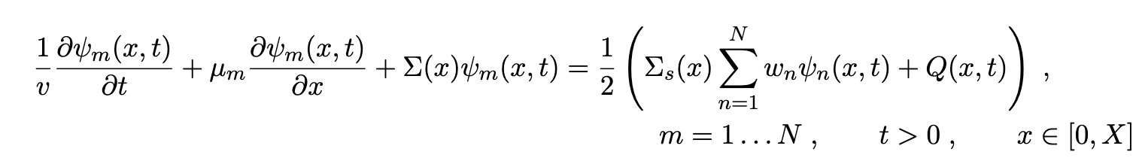
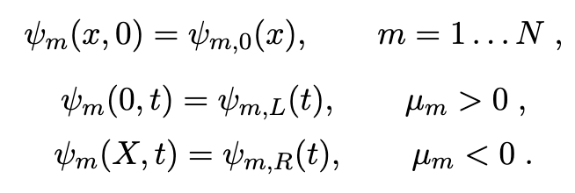
Neutron Transport
kinda
World’s simplest problem…
Assumptions:
Slab geometry
Axi-symmetric
Isotropic source and scattering
G-L quadrature
Monoenergetic
NOT Steady State!!!!

Slide 4
Higher Order Discretization
Time: Time dependent multiple balance [5]
Space: Simple Corner Balance [6]
By coupling two second order schemes we can improve the work v communication paradigm on GPUs
Fourier analysis shows this scheme is second order
Scheme can produce negative fluxes
time edge and half volume integrated quantities
time averaged and half volume integrated quantities
k+1/2
k
time (t)
k-1/2
L
i
R
i+1/2
space (x)

Slide 5
Iterative Methods
Intrgro-PDE requires some kind of iterative method
Very large phase space
We want to go fast ∴ parallelize & hardware accelerate
N_{angle} << N_{cell}
N = 4*N_{time}* N_{angle}*N_{cell}

Slide 6
The Iterative Schemes
initialize φ_{guess}
initialize Ψ_{guess}
compute rhs
φ_{new} becomes φ_{guess}
communicate cellwise bound info
Ψ_{new} becomes ψ_{guess}
source iterations
one cell inversion
solve lhs (sweep)
nope
nope
compute φ_{new}
1
solve for all Ψ_{new}
convergence
convergence?
yup
yup
done!
[3] & [4]
done!

Slide 7

The Iterative Schemes: Graphic
1
2
3
4
5
source iterations
angles
cells
1
2
3
4
5
one cell inversion
angles
cells

Slide 8
SI communicates information between cells within an ordinate WITHIN an iteration
OCI communicates information between cells only BETWEEN iterations

Slide 9
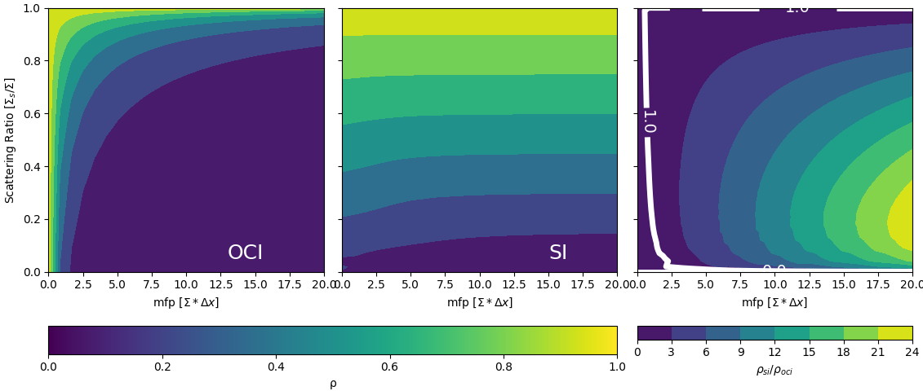
spectral radius

Slide 10
Benefits of OCI on the GPU
Parallelizing over the normally dominant dimension
Lots of independent linear algebra problems
Information is local within an iteration
No K-B-A required in higher dimensions!

Slide 11
The Hunch
While one cell inversions will require more iterations to converge some solutions
Those iterations will be faster when done on the GPU due to decreased thread divergence and parallelization over the dominant dimension (space)
Leading to decreased wall-clock runtime when space is the dominant dimension

Slide 12
Verification Problems
Source free homogeneous pure absorber
Infinite homogeneous medium
AZURV1
MC/DC

Slide 13
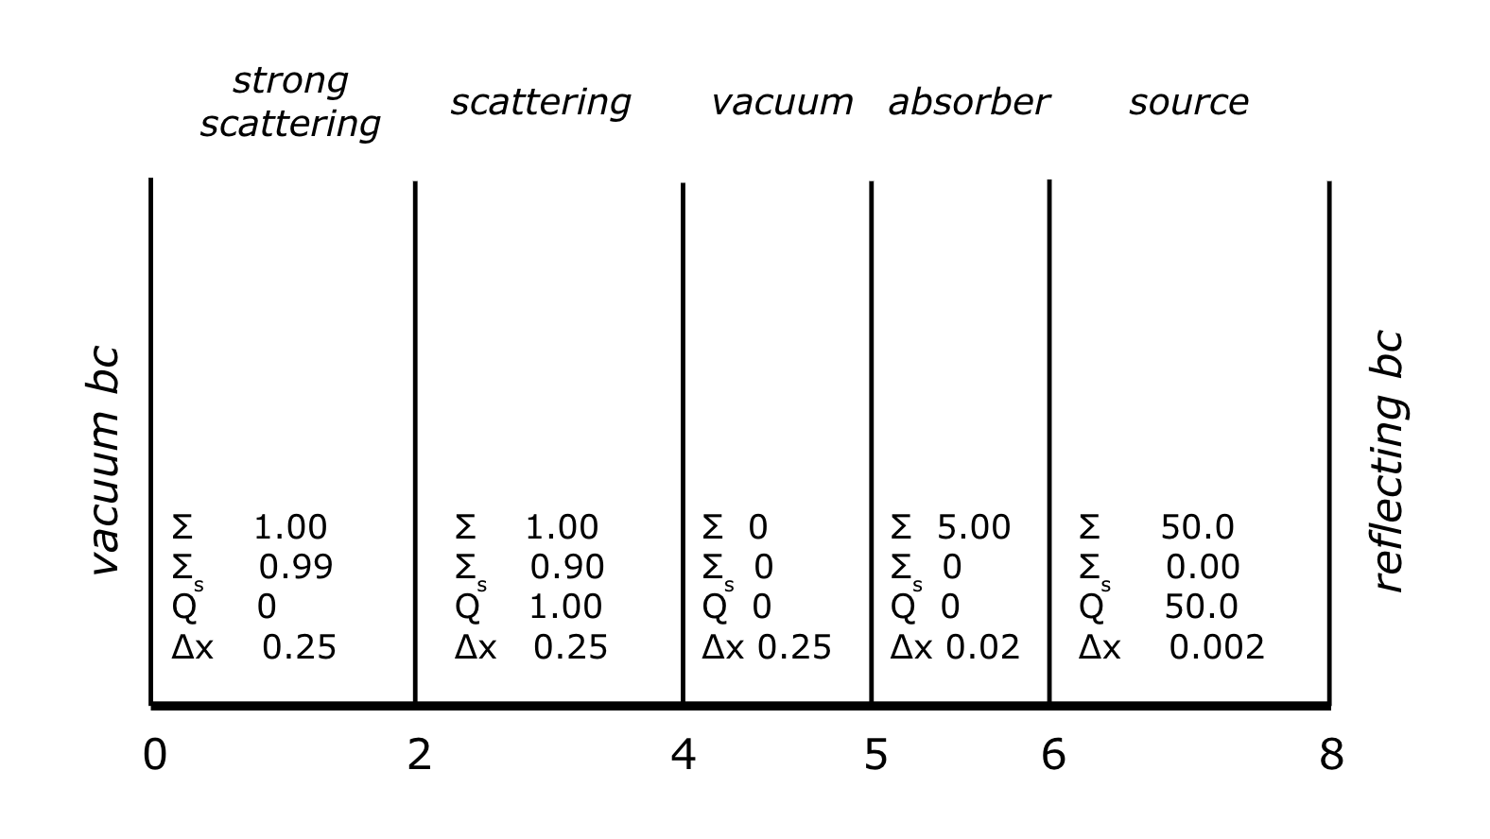
Transient Reed’s problem
Initial Condition: zero everywhere

Slide 14
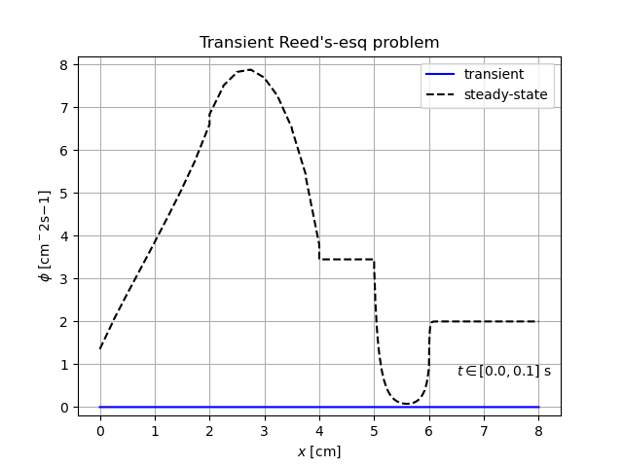
Transient Reed’s problem
Δt = 1s
N_{time} = 5
v = 4cm/s
S₆₄
Wall clock runtime:
OCI 17.01
SI 33.76
2.0X speedup!!!

Slide 15
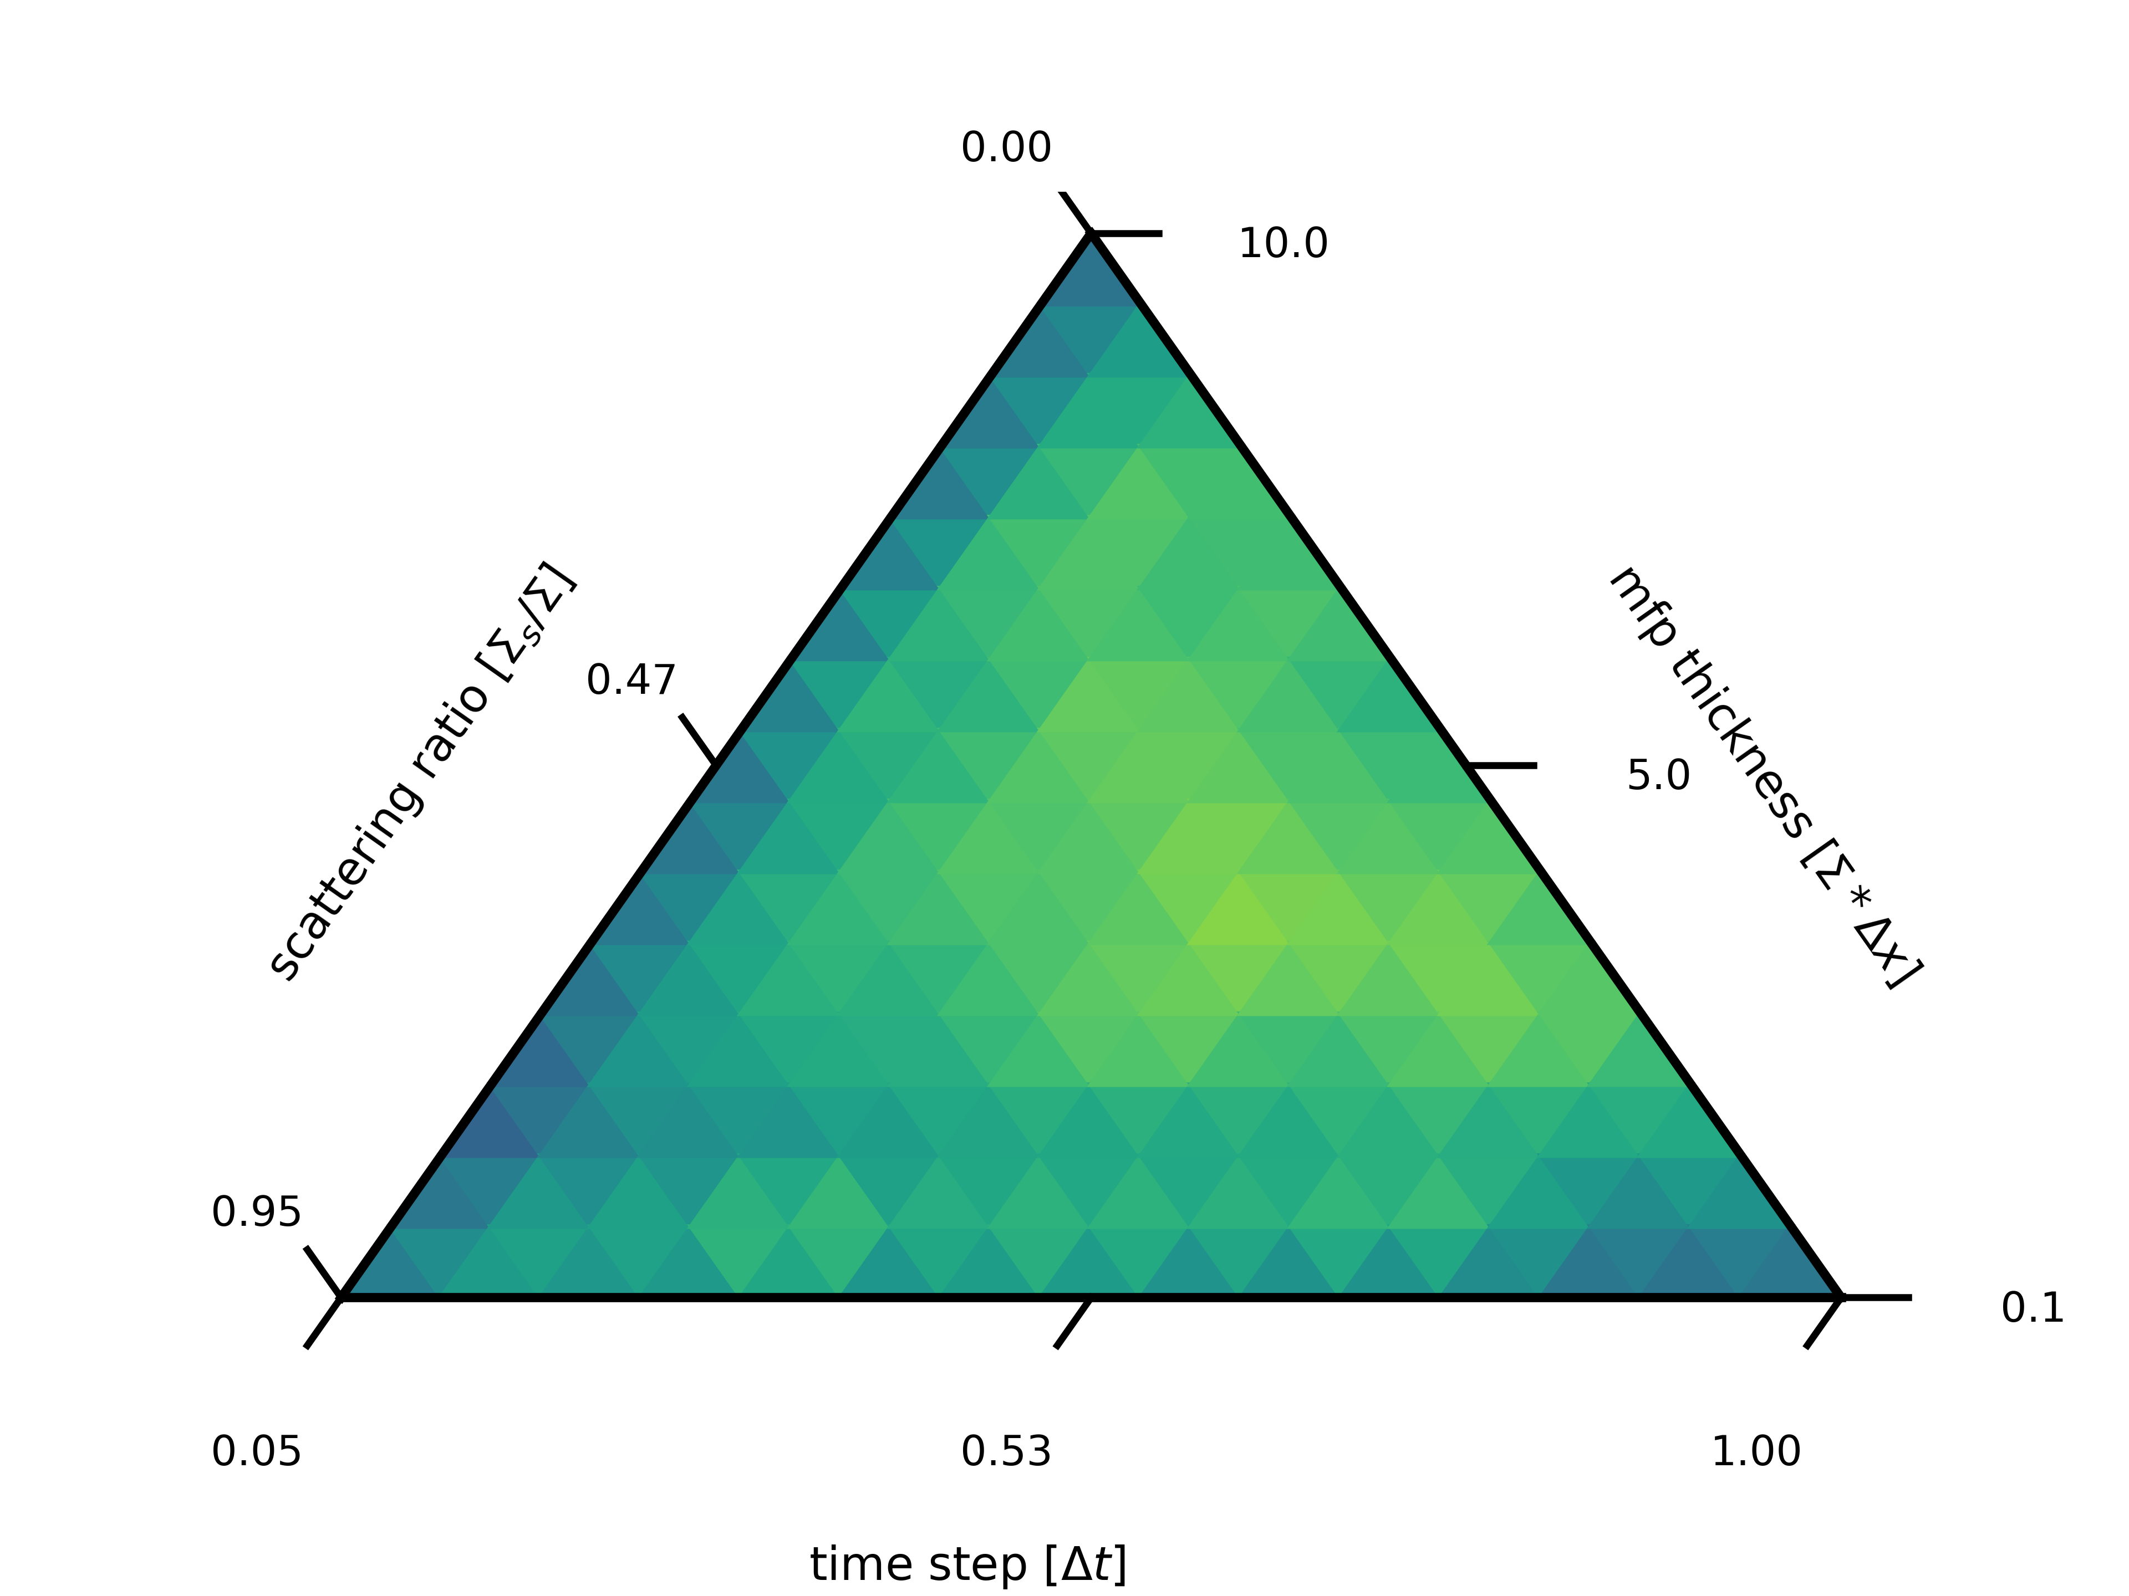
Performance Comparisons
Convergence behavior is governed by:
Scattering ratio
Δt
Quadrature order
Cell thickness in mean-free-paths
vac
vac
v = 4 cm/s
Q = 0.1 s⁻¹cm⁻³
Σ =2 cm⁻¹
10cm

Slide 16
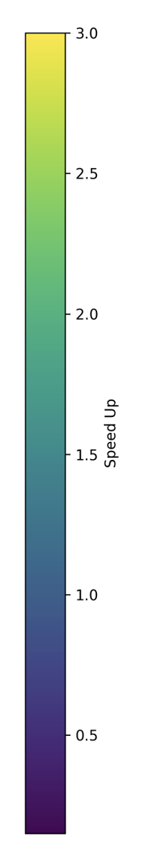
S₄
3.0
2.5
2.0
Speed Up
1.5
1.0
0.5

Slide 17
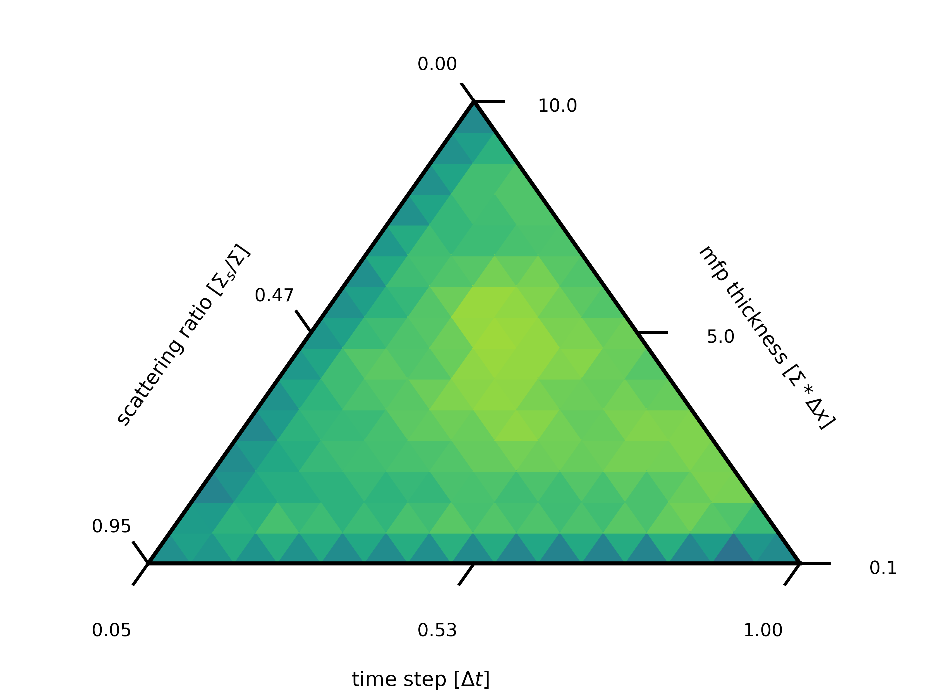
S₁₆
3.0
2.5
2.0
Speed Up
1.5
1.0
0.5

Slide 18
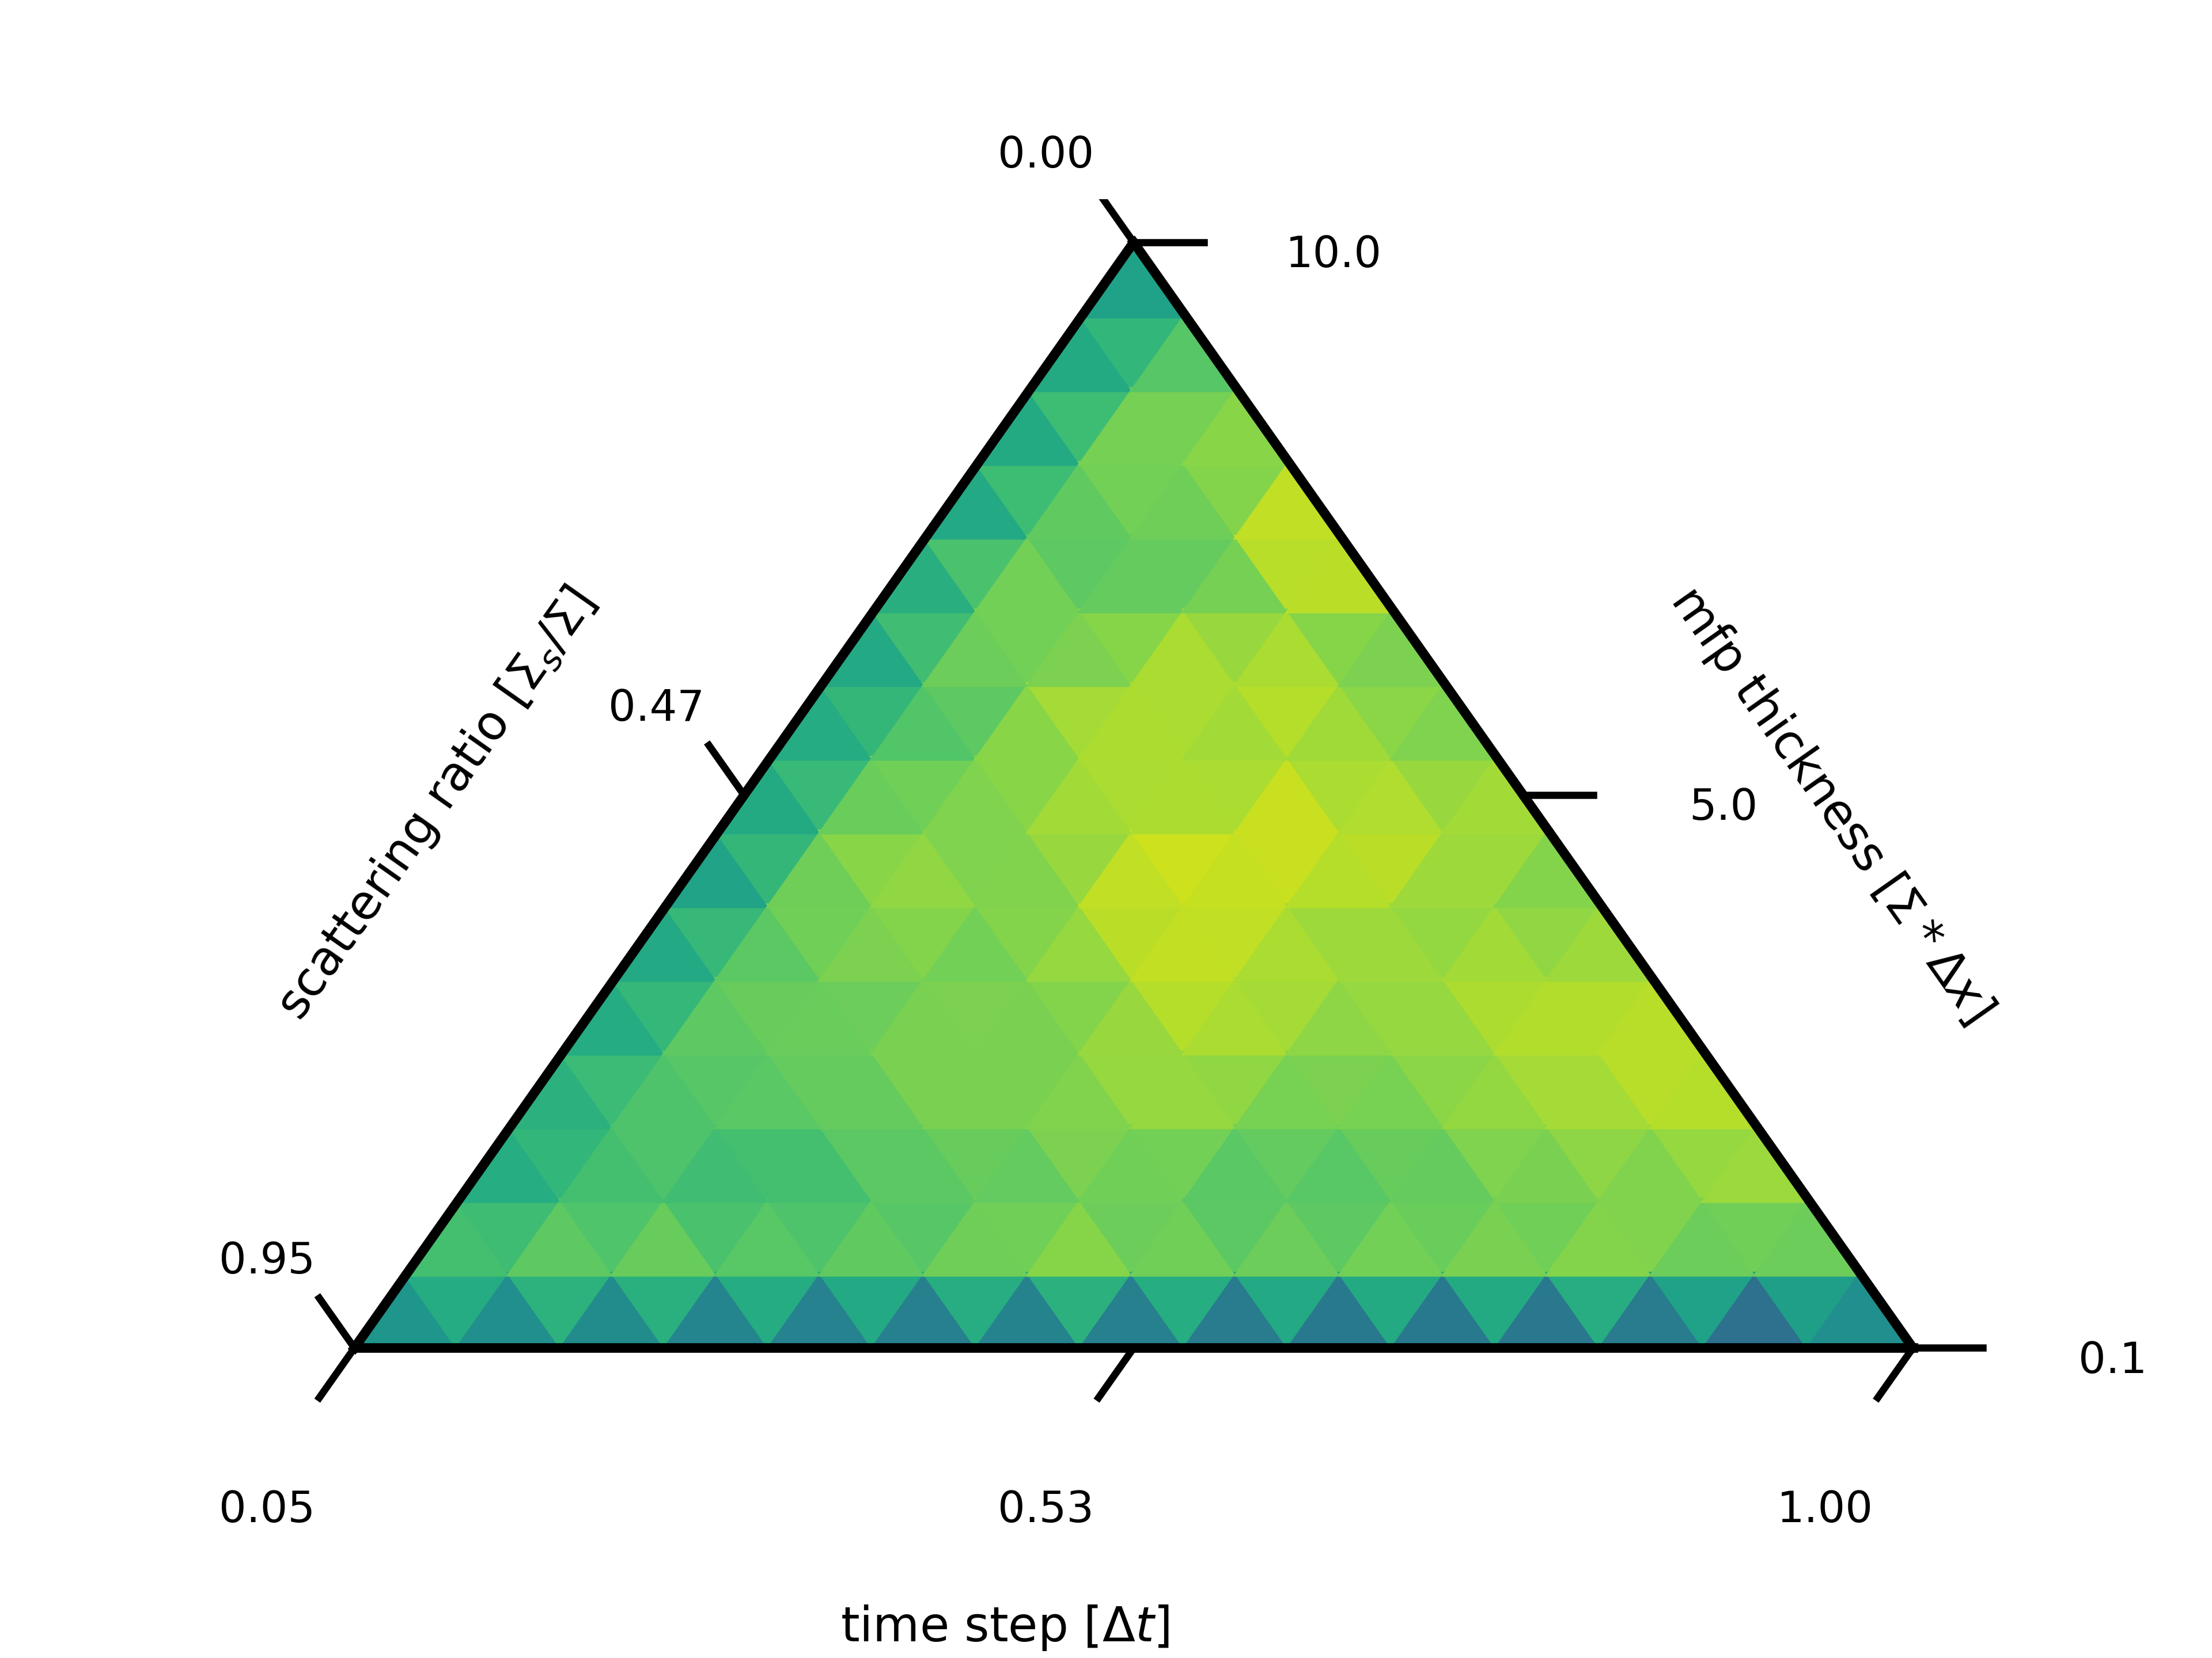
S₃₂
3.0
2.5
2.0
Speed Up
1.5
1.0
0.5

Slide 19
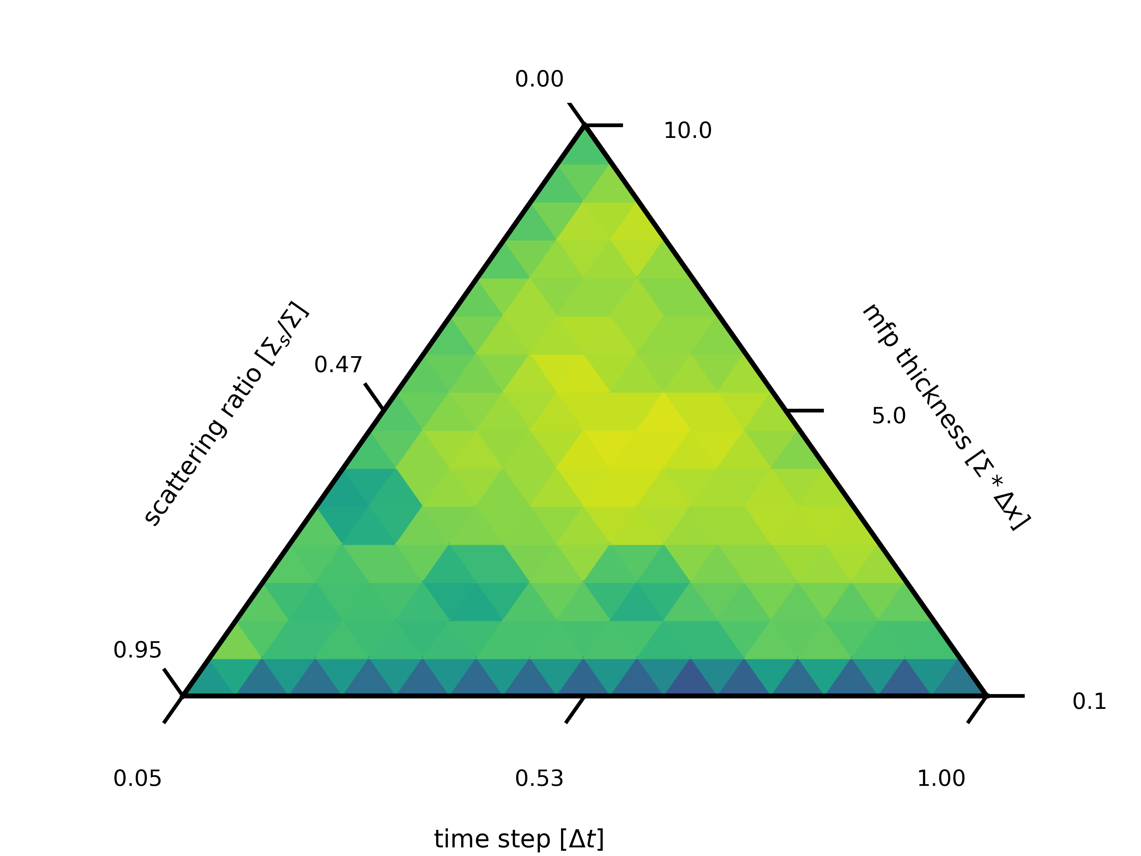
S₆₄
3.0
2.5
2.0
Speed Up
1.5
1.0
0.5

Slide 20
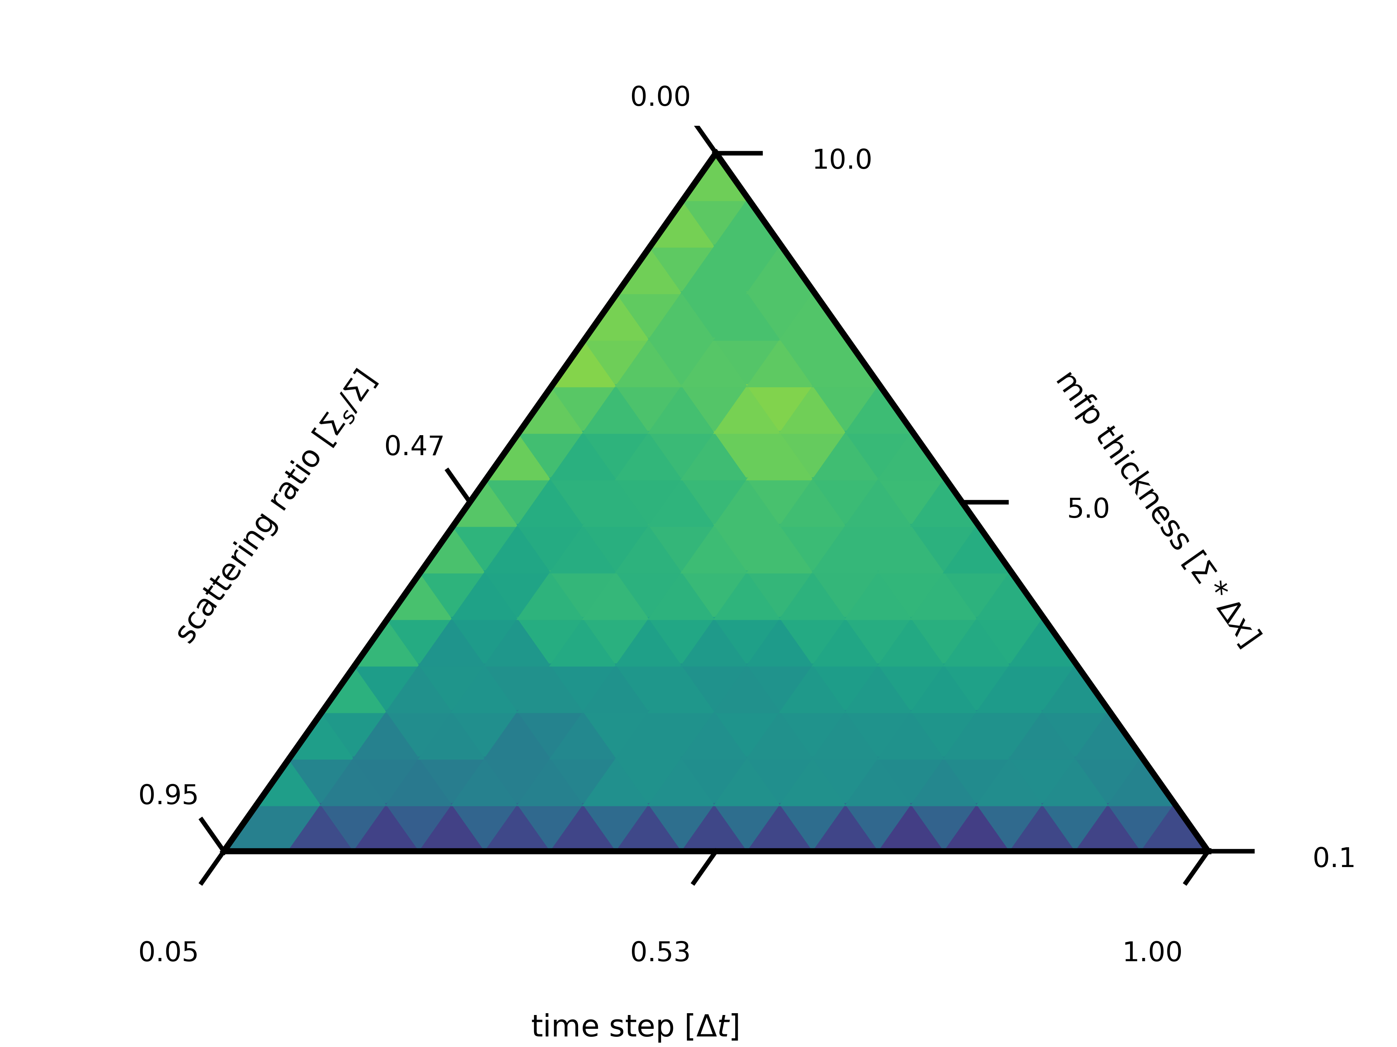
S₁₂₈
3.0
2.5
2.0
Speed Up
1.5
1.0
0.5

Slide 21
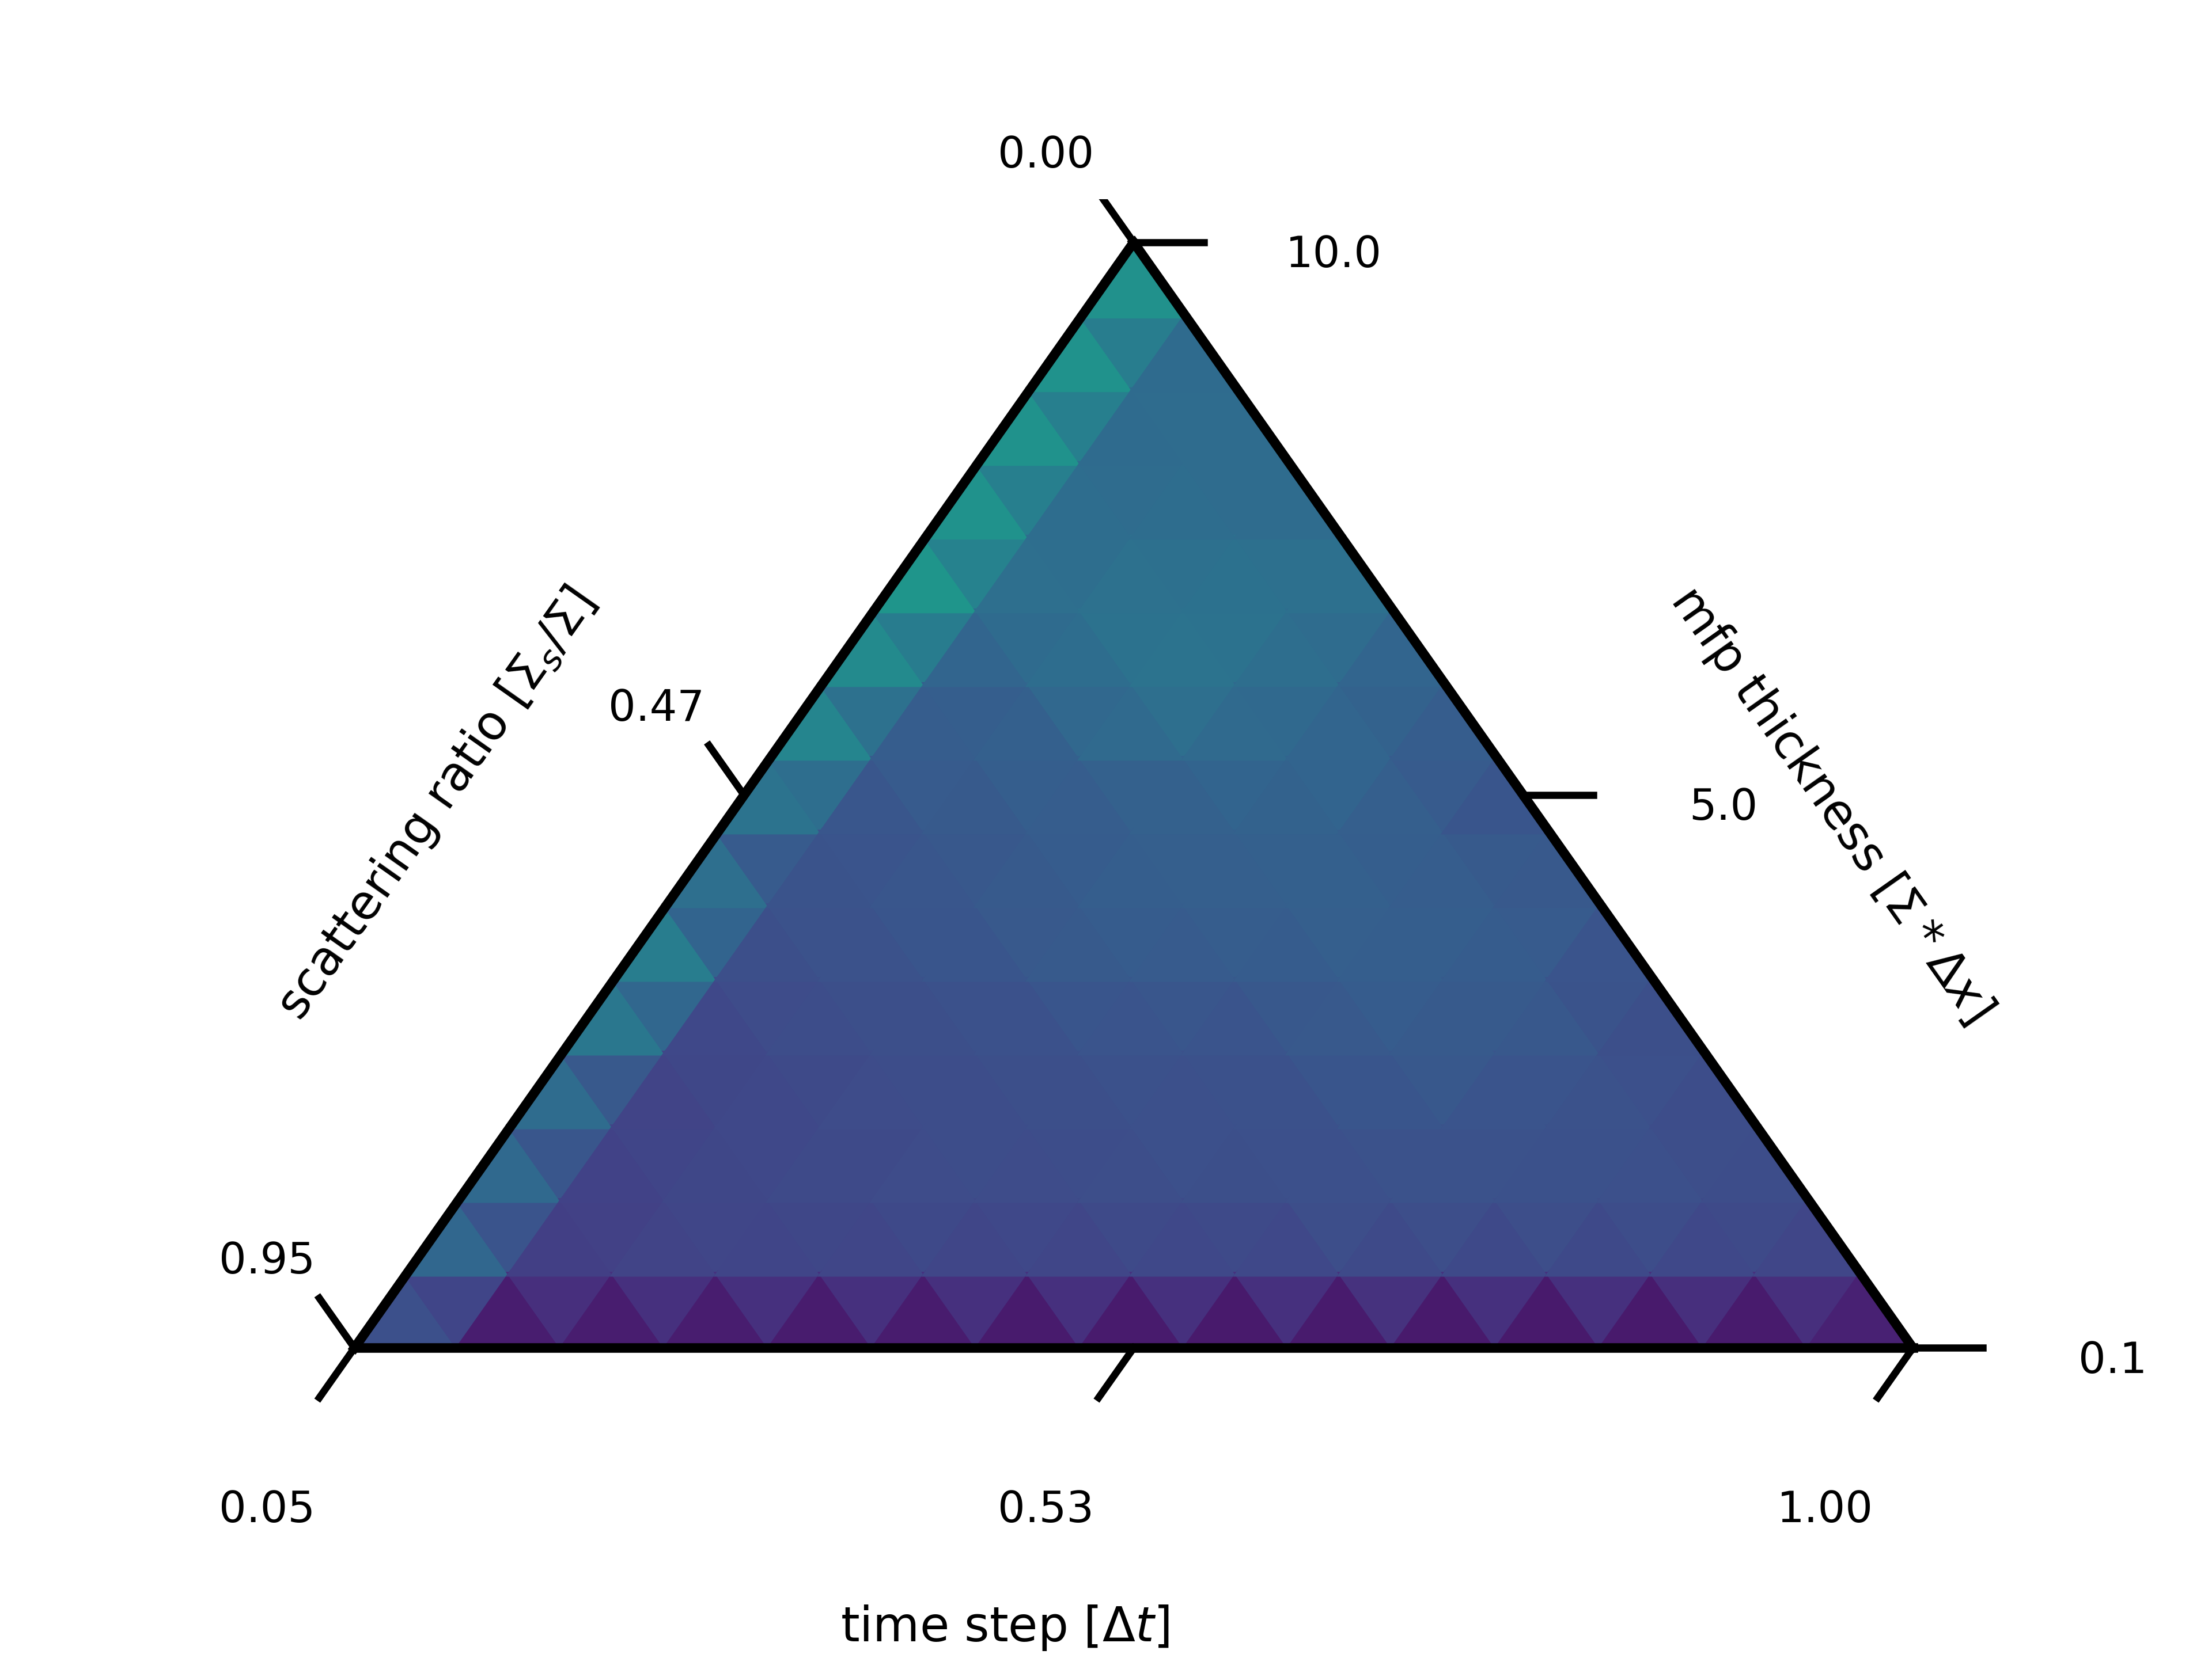
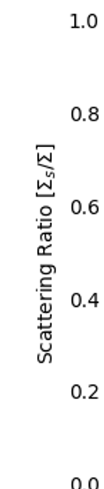
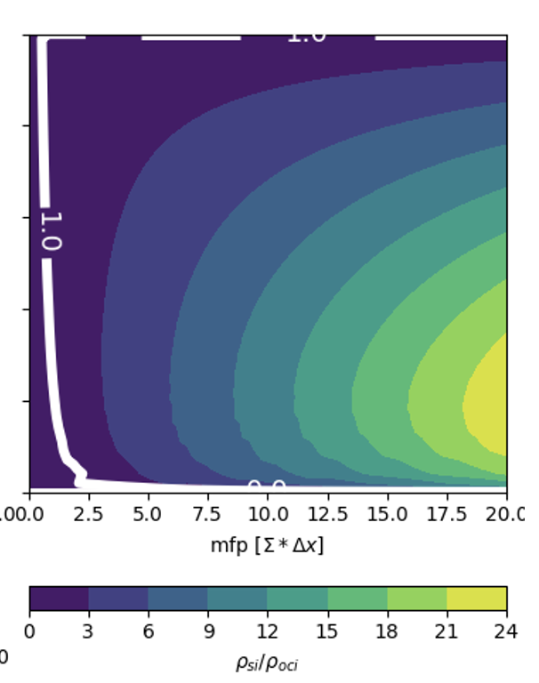
S₂₅₆
3.0
2.5
2.0
Speed Up
1.5
1.0
0.5

Slide 22
Analysis
We overcome communication v work paradigm for GPUs around S₁₆
OCI seems to outperform SI thru S₆₄
As angular quadrature becomes the dominant parallelizable dimension, SI wins out, with no speed up found by S₂₅₆

Slide 23
Conclusions
OCI outperforms SI in parallel performance when there are many many more cells then angles on GPUs
OCI is least effective, compared with SI, for problems that are highly scattering

Slide 24
Future Work
Explorations with preconditioners and/or synthetic acceleration
Energy dependence, converging all groups at the same time
Explorations of exascale hardware (large memory bus between GPU and CPU)
Performance comparison of developer toolchains across hardware

Slide 25
Questions
Code github.com/CEMeNT-PSAAP/Therefore
Center cement-psaap.github.io
This work was supported by the Center for Exascale Monte-Carlo Neutron Transport (CEMeNT) a PSAAP-III project funded by the Department of Energy, grant number: DE-NA003967.

Slide 26
Citations
[1] M. L. Adams and E. W. Larsen. “Fast iterative methods for discrete-ordinates particle transport calculations.” Progress in nuclear energy, 40(1), pp. 3–159 (2002).
[2] R. S. Baker. “An SN Algorithm for Modern Architectures.” Nuclear science and engineering, 185(1), pp. 107–116 (2017)
[3] D. Anistratov and Y. Y. Azmy. “Iterative stability analysis of spatial domain decomposition based on block Jacobi algorithm for the diamond-difference scheme.” Journal of Computational Physics, 297(C), pp. 462–479 (2015).
[4] D. S. Hoagland and Y. Y. Azmy. “Hybrid approaches for accelerated convergence of block-Jacobi iterative methods for solution of the neutron transport equation.” Journal of Computational Physics, 439(2021). URL https://www.osti.gov/biblio/1815296.
[5] I. Variansyah, E. W. Larsen, and W. Martin. “A Robust Second-Order Multiple Balance Method for Time-Dependent Neutron Transport Simulations.” The European Physical Journal Conferences, 247, p. 03024 (2021).
[6] M. L. Adams. “Subcell balance methods for radiative transfer on arbitrary grids.” Transport Theory and Statistical Physics, 26(4-5), pp. 385–431 (1997). URL https://doi.org/10.1080/00411459708017924

